Slide 1

CSE 350 Digital Electronics and Pulse Techniques
RTL circuits
Course Instructor: Shomen Kundu (SDU)
Mail: shomen.kundu@bracu.ac.bd
Desk: 4N139

Slide 2
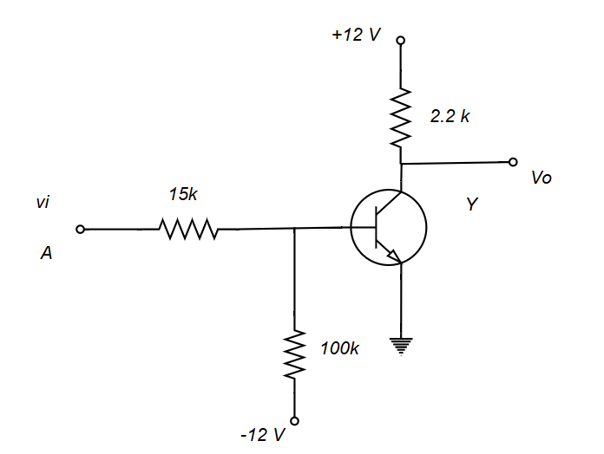
Resistor Transistor Logic (RTL)
Not gate

Slide 3
Resistor Transistor Logic (RTL)
Case 1: A = 0 , vi = 0 V
# input low, output
expected to be high.
We need to prove it.
Assumption: Cutoff mode

Slide 4
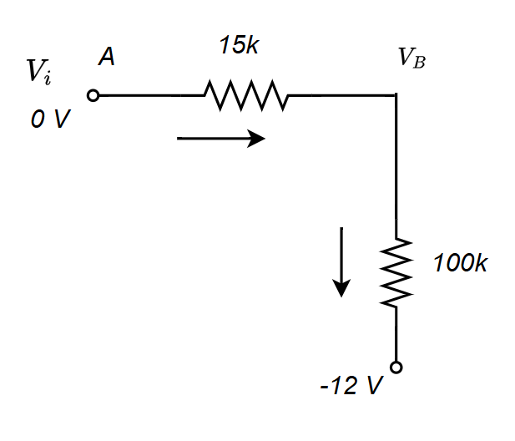

Resistor Transistor Logic (RTL)
Verification
$$\frac{0−V_{b}}{15 k }=\frac{V_{b}−\left(−12\right)}{100k}=>V_{B}=−1.565 V ,$$
$${ Here, V}_{E}=0$$
As V_{BE} = -1.565 V<0.7 V , and $V_{BC}=−13.565 V$ Assumption is correct
For cutoff mode: $I_{B}=I_{C}=I_{E}=0$
$$I_{C}=0= \frac{12−Vc}{2.2 k} , V_{C}=12 V$$

Slide 5
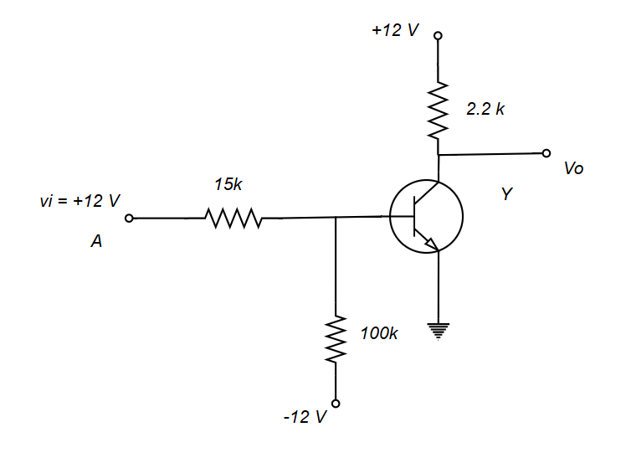

Resistor Transistor Logic (RTL)
Case 2: $A = 1 , V_{i} = 12 V$
# input high, output
expected to be low.
$$V_{CE}=0.2 V$$
We can expect this BJT
to be operating in saturation mode.
Assumption: Saturation mode

Slide 6
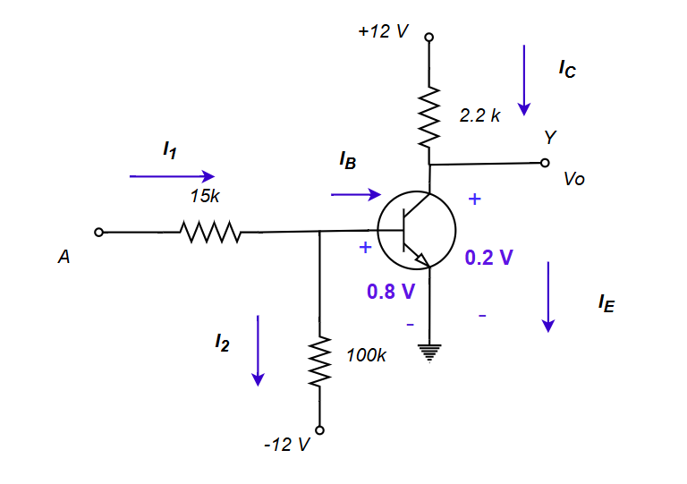

Resistor Transistor Logic (RTL)
$$I_{C}= \frac{12−0.2}{2.2 k }=5.36 mA$$
$$T→Saturation, V_{BE}=0.8 V and V_{CE}=0.2 V$$
$$I_{1}= \frac{12−0.8}{15 k }=0.746 mA$$
$$I_{2}= \frac{0.8−(−12)}{100 k }=0.128 mA$$
$$I_{B}+I_{2}−I_{1}=0$$
$$I_{B}=I_{1}−I_{2}=0.619 mA$$
$${Here, β}_{forced}= \frac{I_{C}}{I_{B} }=8.659<β_{F}$$
( Saturation assumption is correct )

Slide 7
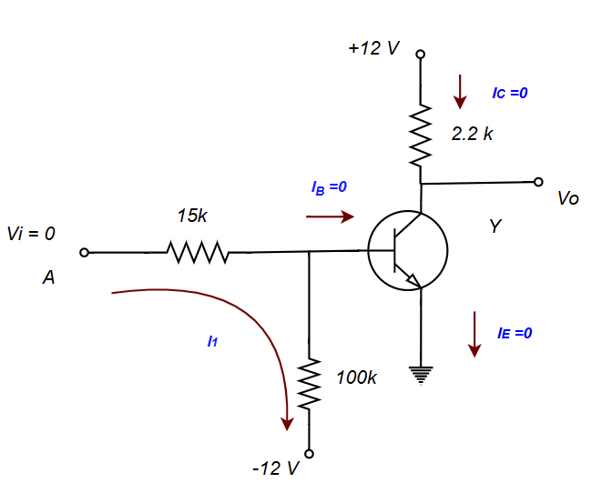
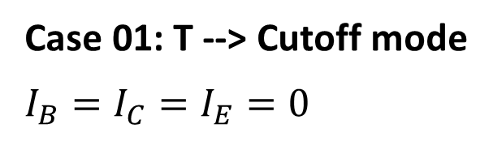
Power dissipation for RTL inverters:
Case 01: T --> Cutoff mode
$$I_{B}=I_{C}=I_{E}=0$$

Slide 8
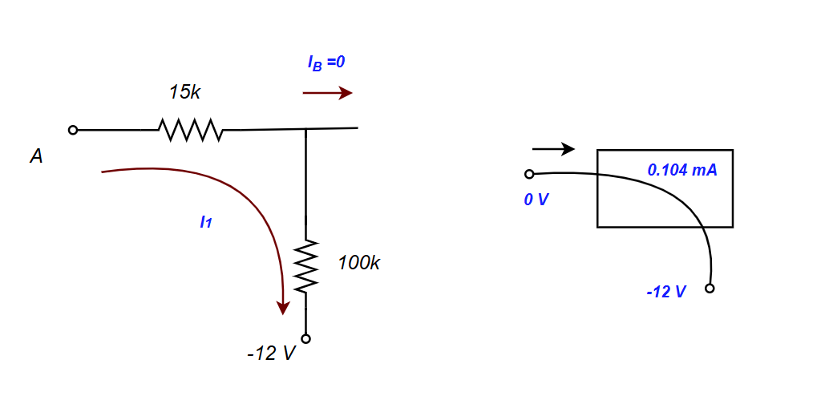
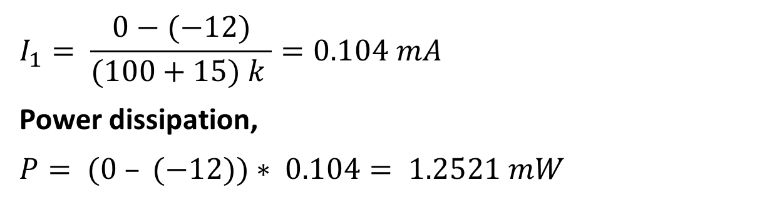
Power dissipation for RTL inverter
$$I_{1}= \frac{0−(−12)}{(100+15) k }=0.104 mA$$
Power dissipation,
$P= (0 – (−12))∗ 0.104$ $= 1.2521 mW$

Slide 9

Power dissipation for RTL inverter
Case 2: $A = 1 , Vi = 12 V$
# input high, output
expected to be low.
$$V_{CE} = 0.2 V, V_{BE} = 0.8 V$$
We can expect this BJT
to be operating in saturation mode.
Assumption: Saturation mode

Slide 10

Power dissipation for RTL inverter
$$IC= \frac{12−0.2}{2.2 k }=5.36 mA$$
$$T→Saturation,$$
$$V_{BE}=0.8 V and V_{CE}=0.2 V$$
$$I_{1}= \frac{12−0.8}{15 k }=0.746 mA$$
$$I_{2}= \frac{0.8−(−12)}{100 k }=0.128 mA$$
$$IB+I2−I1=0$$
$$IB=I1−I2=0.619 mA$$
$$βforced= \frac{IC}{IB }=8.659<βF$$
$$( Saturation assumption is correct )$$

Slide 11
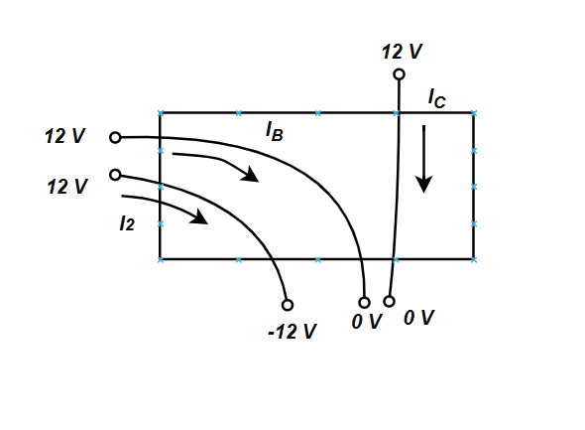
Power dissipation for RTL inverter

Slide 12
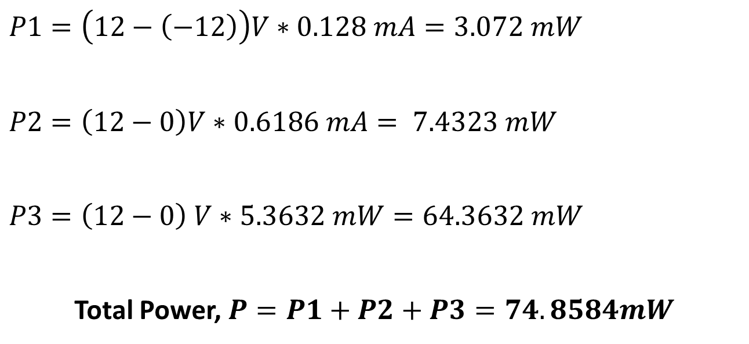
Power dissipation for RTL inverter
$$P1=\left(12−\left(−12\right)\right)V∗0.128 mA=3.072 mW$$
$$P2=\left(12−0\right)V∗0.6186 mA= 7.4323 mW$$
$$P3=\left(12−0\right) V∗5.3632 mW=64.3632 mW$$
Total Power, $P=P1+P2+P3=74.8584mW$

Slide 13
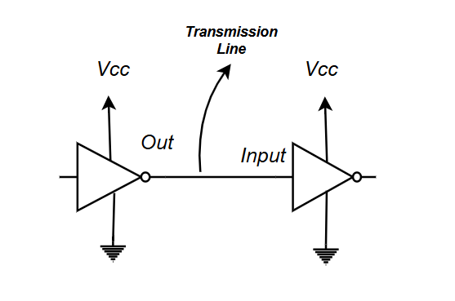
Noise Margin
Output from one inverter is received as input to the next inverter.
External interference, noise can hamper the signal transmission

Slide 14
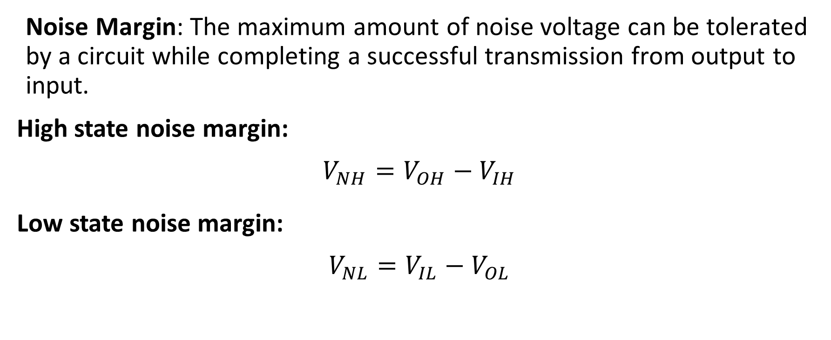
Noise Margin
Noise Margin: The maximum amount of noise voltage can be tolerated by a circuit while completing a successful transmission from output to input.
High state noise margin:
$$V_{NH}=V_{OH}−V_{IH}$$
Low state noise margin:
$$V_{NL}=V_{IL}−V_{OL}$$

Slide 15
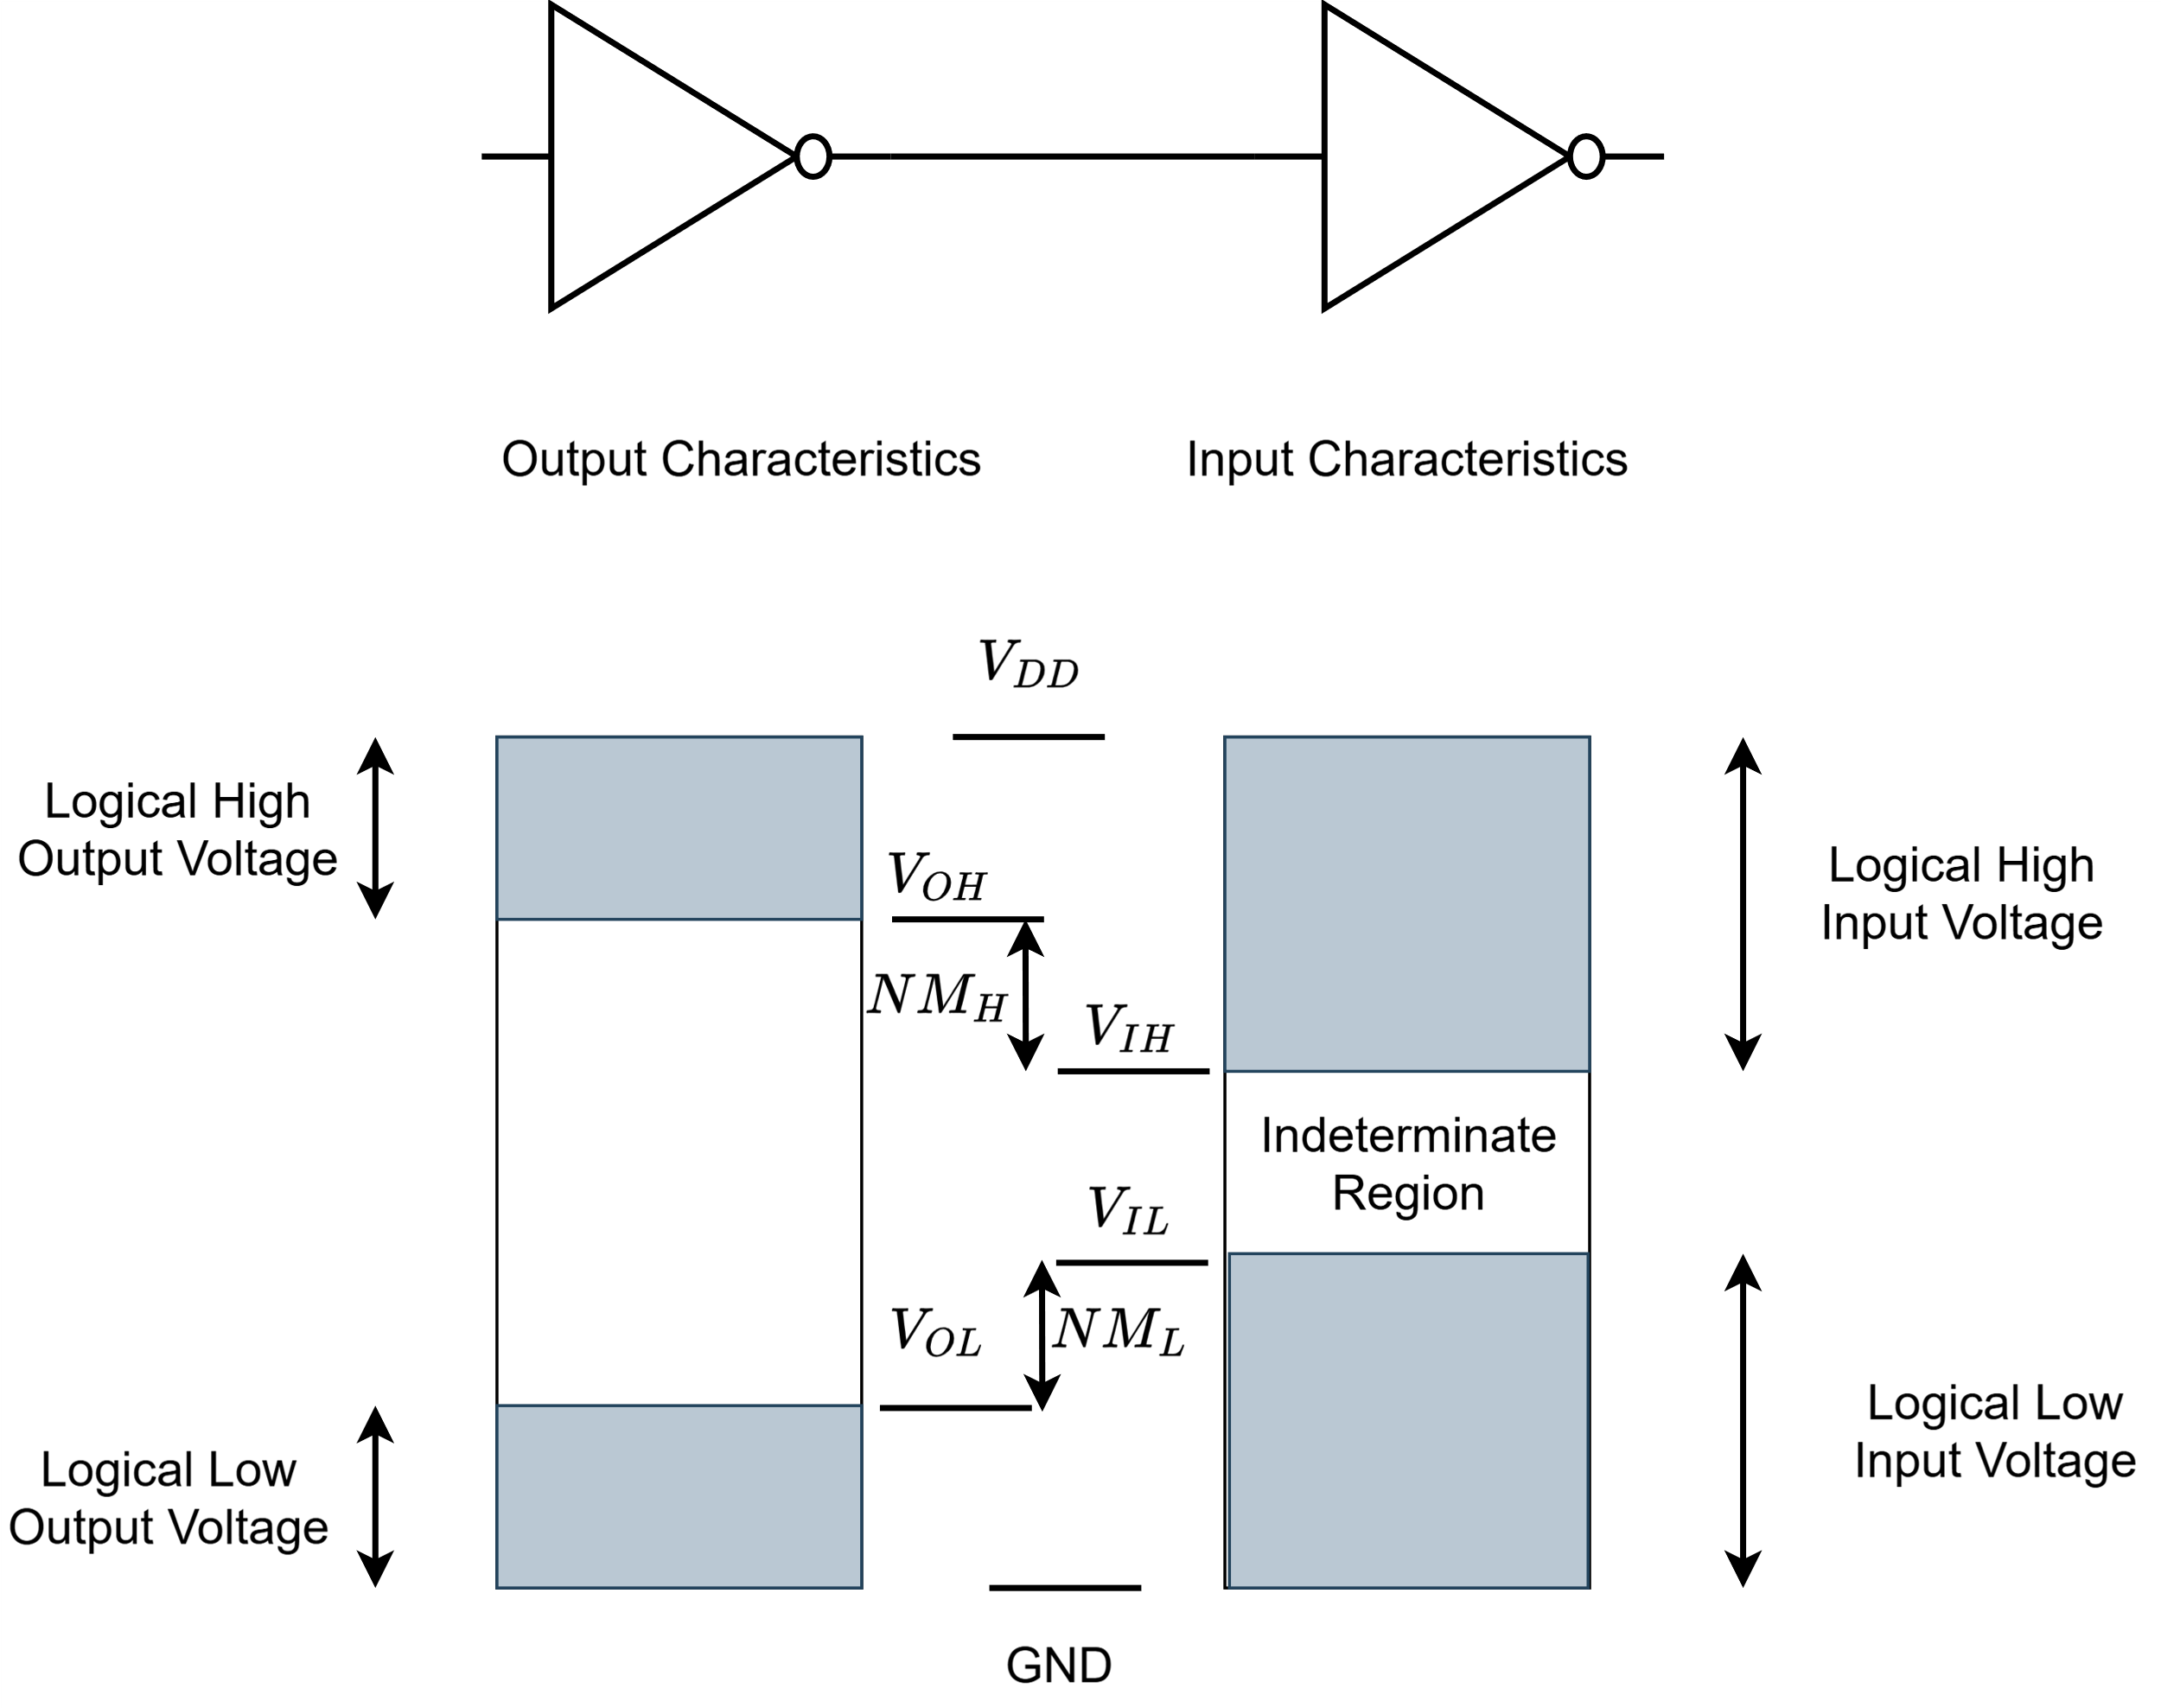
Noise Margin

Slide 16
Noise Margin
V_{OH} → The minimum voltage level at an output in logical ‘1’ state under defined load condition
V_{IH} → The minimum voltage level at an input in logical ‘1’ state under defined load condition
V_{OL} → The maximum voltage level at an output in the logical ‘0’ state under defined load condition.
V_{IL} → The maximum voltage level at an input in the logical ‘0’ state under defined load condition.

Slide 17
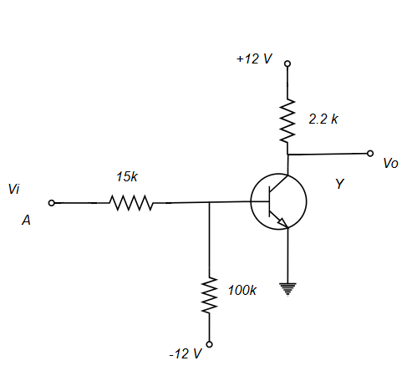
Example:
The output voltage might drop 0.5V from the maximum voltage. Find out the Noise Margin of the circuit. Given β_{F}= 30.
V_{OL} Calculation:
When input is high output should be low and BJT will remain at the saturation mode.
Max Vo for saturation mode will be 0.2 V
V_{OL} = 0.2 V ( saturated)
V_{OH} Calculation:
Maximum output voltage = 12V ,
V_{OH} = 12 -0.5 =11.5 V

Slide 18
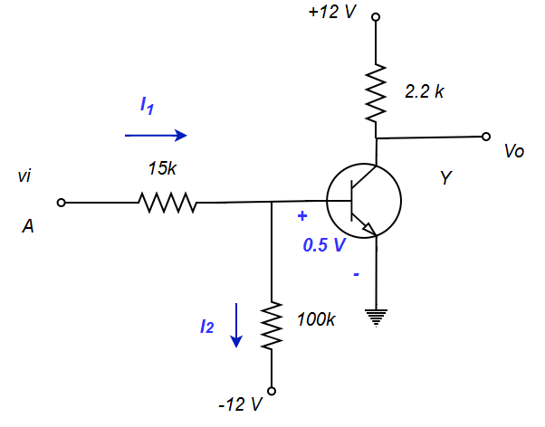
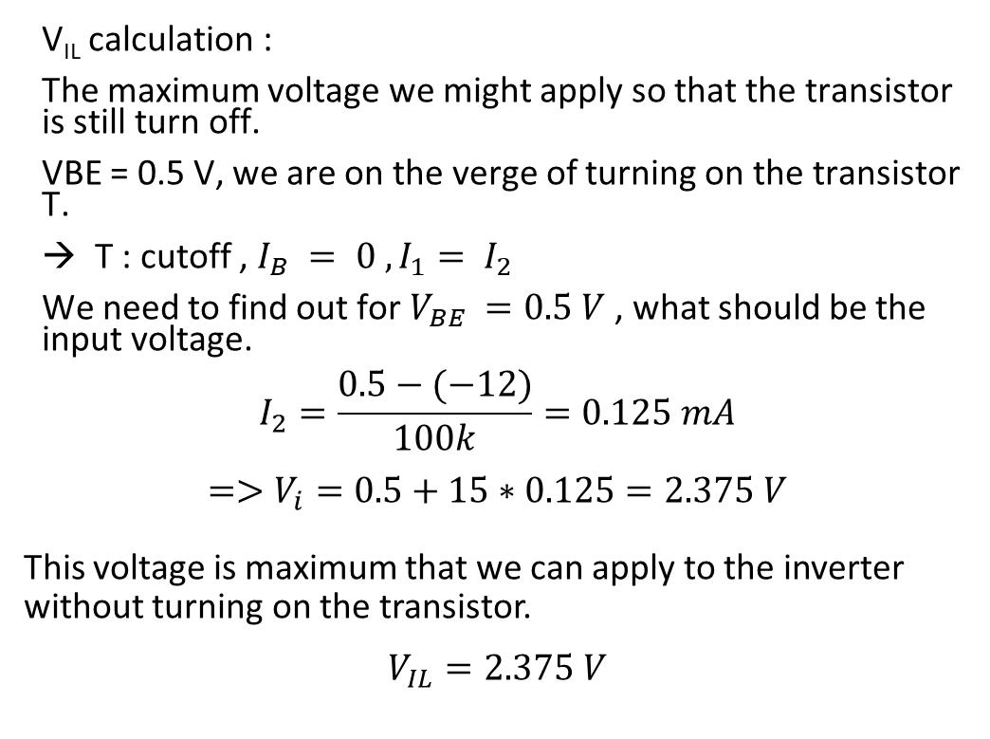
Noise Margin
V_{IL} calculation :
The maximum voltage we might apply so that the transistor is still turn off.
VBE = 0.5 V, we are on the verge of turning on the transistor T.
T : cutoff , $I_{B} = 0 , I_{1}= I_{2}$
We need to find out for $V_{BE} =0.5 V$, what should be the input voltage.
$$I_{2}=\frac{0.5−(−12)}{100k}=0.125 mA$$
$$=>V_{i}=0.5+15∗0.125=2.375 V$$
This voltage is maximum that we can apply to the inverter without turning on the transistor.
$$V_{IL}=2.375 V$$

Slide 19
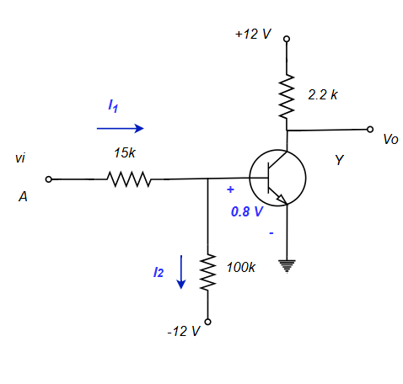
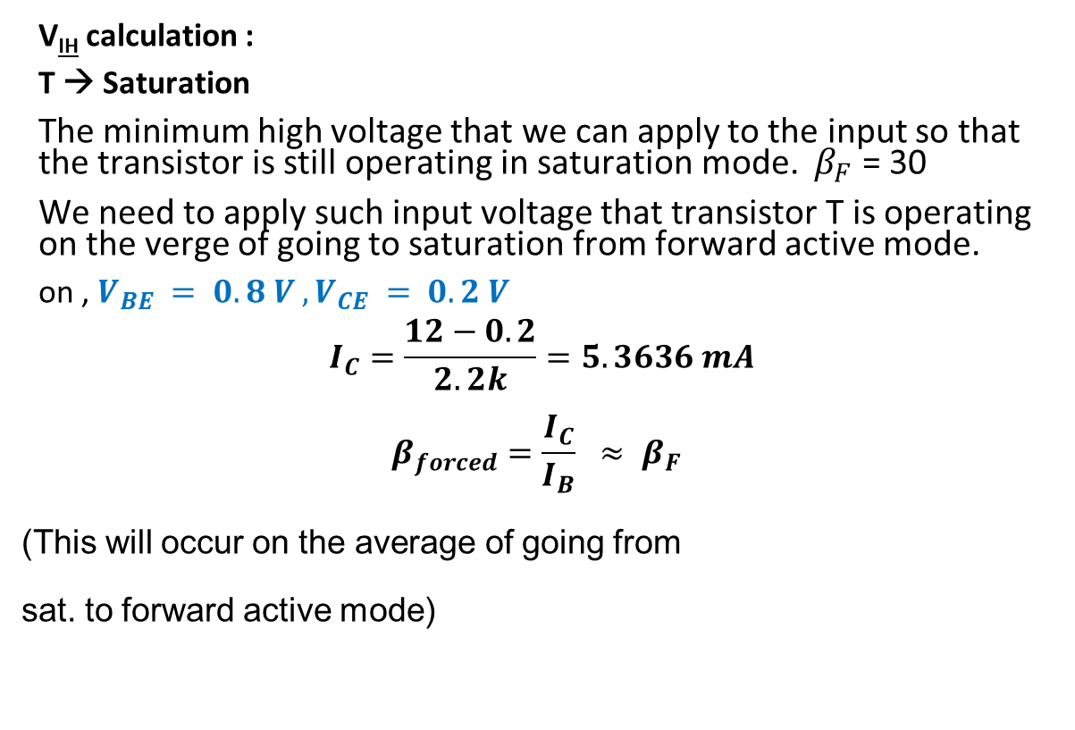
Noise Margin
V_{IH} calculation :
T → Saturation
The minimum high voltage that we can apply to the input so that the transistor is still operating in saturation mode. $β_{F}$ = 30
We need to apply such input voltage that transistor T is operating on the verge of going to saturation from forward active mode.
on , $V_{BE} = 0.8 V , V_{CE} = 0.2 V$
$$I_{C}=\frac{12−0.2}{2.2k}=5.3636 mA$$
$$β_{forced}=\frac{I_{C}}{I_{B}} ≈ β_{F }$$
(This will occur on the average of going from
sat. to forward active mode)

Slide 20

Noise Margin
$I_{B}=\frac{I_{C}}{β_{F}}$ = 0.1788 mA,
$$I_{2}=\frac{0.8−\left(−12\right)}{100k}=0.128 mA$$
$$I_{1}=I_{2}+I_{B}=0.3068 mA$$
$$\frac{V_{i}−0.8}{15k}=I_{1}=0.3068$$
$$V_{i}=0.8+0.3068∗15=5.4018 V$$

Slide 21

Noise Margin
$$V_{NH}=11.5−5.4018=6.0982 V<−High noise margin$$
$$V_{NL}=2.375−0.2=2.175 V<−Low noise margin$$
$Noise Margin=min\left( V_{NH}, V_{NH}\right)=2.175 V$
This noise voltage can be tolerated for both input and output voltages.

Slide 22
Fanout
Fanout:
The maximum number of logic inputs ( of the same logic family ) that an output can drive reliably is called maximum fanout.
calculate fanout → maximum fanout
fanout given in question may not be maximum

Slide 23
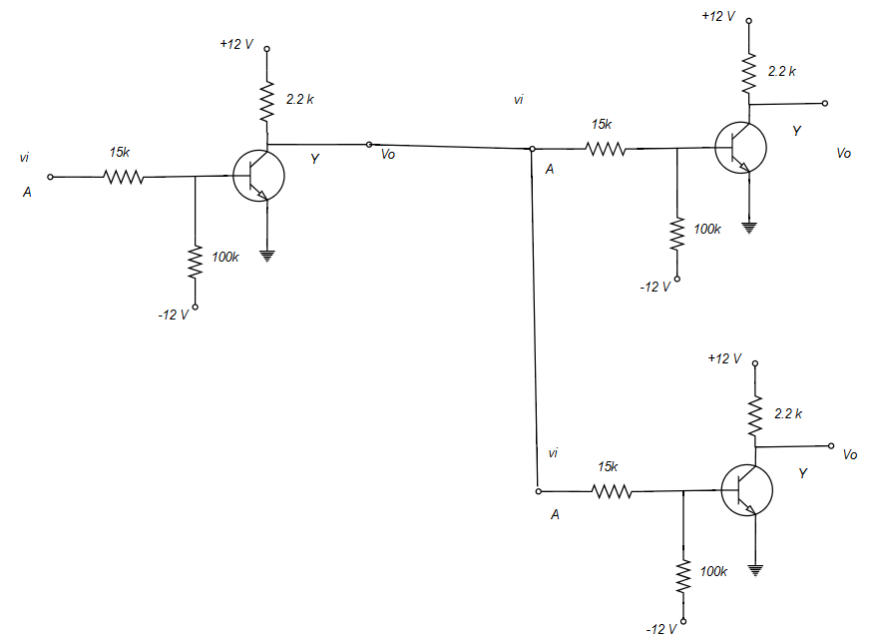
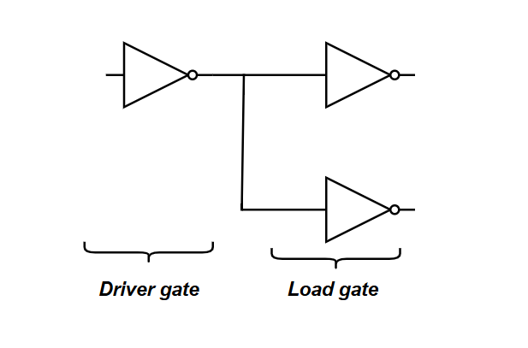
Fanout
Here output is connected with two other gate input. Fanout = 2

Slide 24
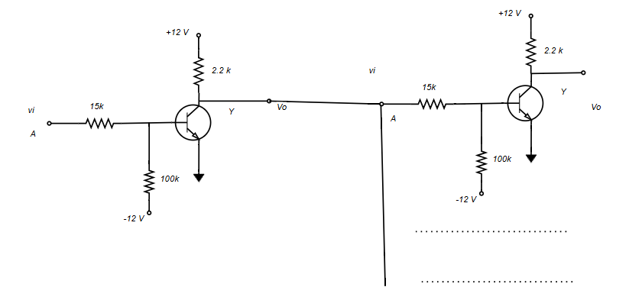
Fanout
Example: Calculate the fanout of the RTL circuit. Assume V_{OH} = 10V.

Slide 25
Fanout
Driver gate → Supply current
Load gate → Consume current
Two case:
Case 1: Driver output Low,
Case 2: Driver output high
Calculate:
1. Individual demand current for each load circuit/ gate
2. The maximum current that can be supplied from driver circuit

Slide 26
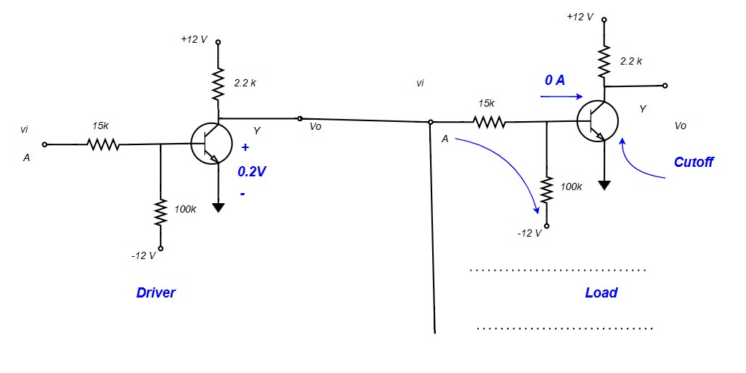
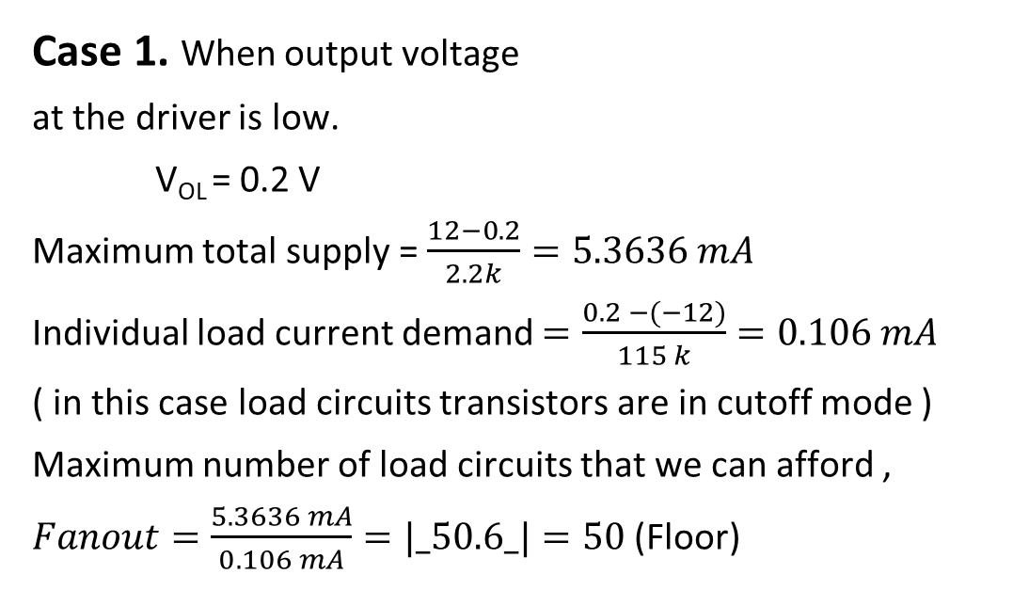
Fanout
Case 1. When output voltage
at the driver is low.
V_{OL} = 0.2 V
Maximum total supply = $\frac{12−0.2}{2.2k}=5.3636 mA$
Individual load current demand $=\frac{0.2 −(−12)}{115 k}=0.106 mA$
( in this case load circuits transistors are in cutoff mode )
Maximum number of load circuits that we can afford ,
$Fanout=\frac{5.3636 mA}{0.106 mA}=|_50.6_|=50$ (Floor)

Slide 27
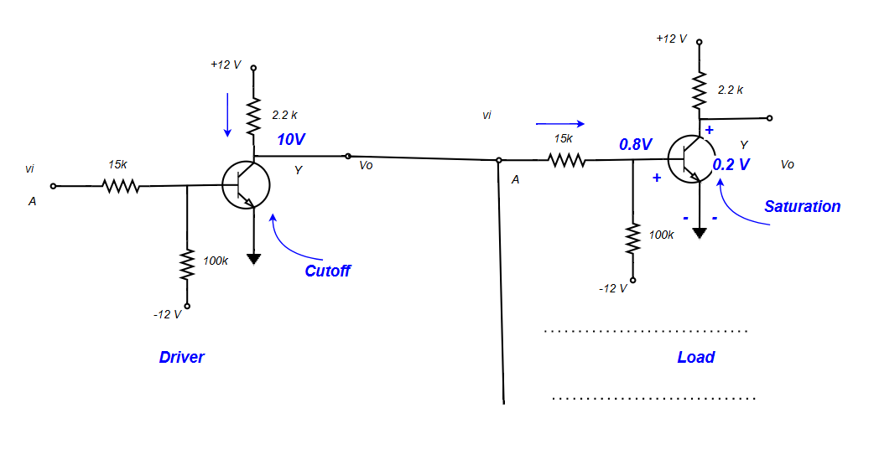
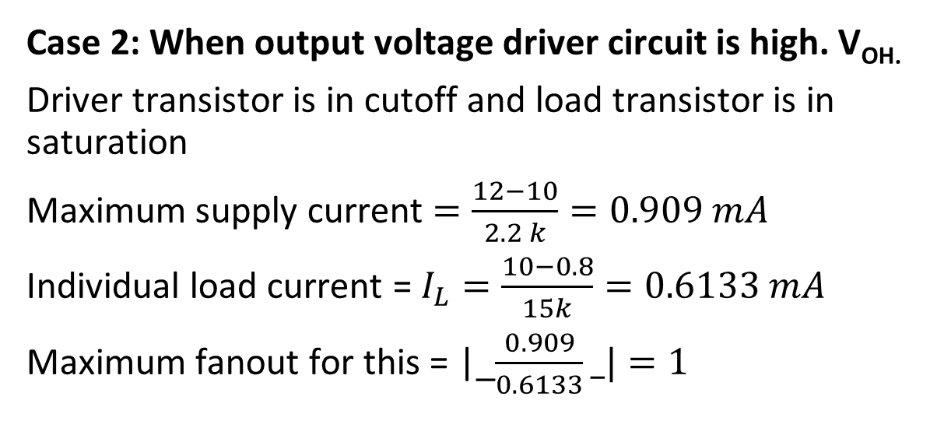
Fanout
Case 2: When output voltage driver circuit is high. V_{OH.}
Driver transistor is in cutoff and load transistor is in saturation
Maximum supply current $=\frac{12−10}{2.2 k}=0.909 mA$
Individual load current = $I_{L}=\frac{10−0.8}{15k}=0.6133 mA$
Maximum fanout for this = |_$\frac{0.909}{0.6133}_|=1$

Slide 28
Fanout
Overall maximum fanout must be calculated by considering worst case scenario.
To prevent malfunction of driver circuit , we need to take the minimum of the two cases.
Max Fanout = Min ( 50,1 ) = 1

Slide 29
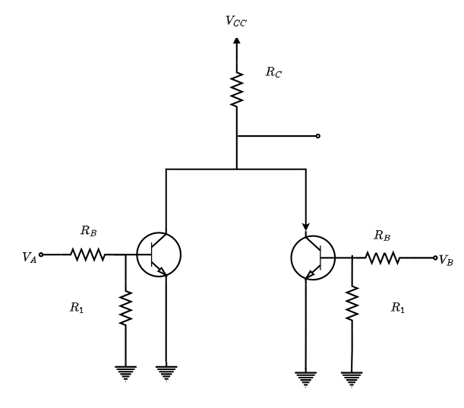
RTL NOR Gate

Slide 30
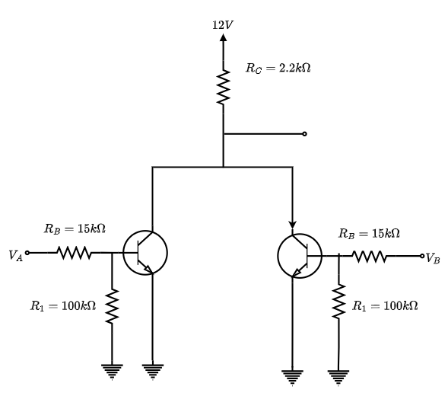
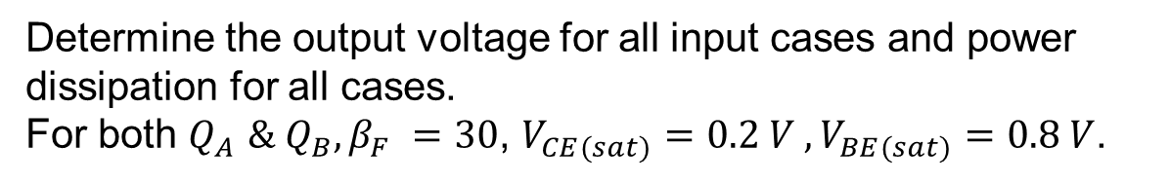
RTL NOR Gate
Determine the output voltage for all input cases and power dissipation for all cases. For both $Q_{A}$ $\& Q_{B}, β_{F} =30$, $V_{CE(sat)}=0.2 V , V_{BE(sat)}=0.8 V$.

Slide 31
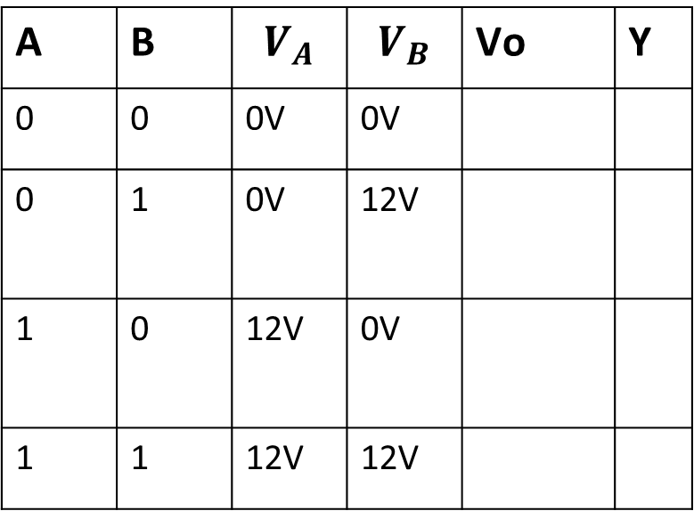
RTL NOR Gate
As the input is two, there will be four different cases,
A | B | $$V_{A}$$ | $$V_{B}$$ | Vo | Y
0 | 0 | 0V | 0V
0 | 1 | 0V | 12V
1 | 0 | 12V | 0V
1 | 1 | 12V | 12V

Slide 32
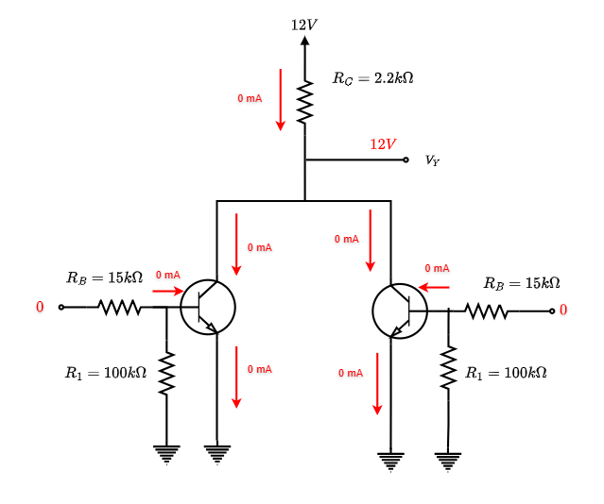
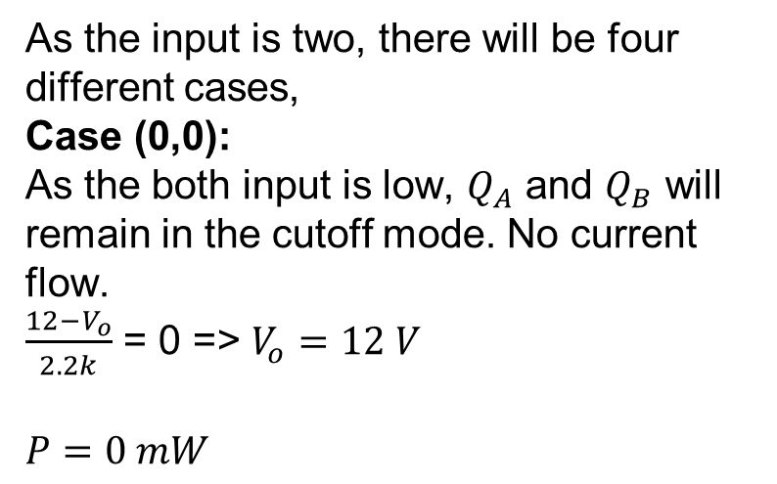
RTL NOR Gate
As the input is two, there will be four different cases, Case (0,0):
As the both input is low, $Q_{A}$ and $Q_{B}$ will remain in the cutoff mode. No current flow.
$\frac{12−V_{o}}{2.2k}$ = 0 => $V_{o}=12 V$
$$P=0 mW$$

Slide 33
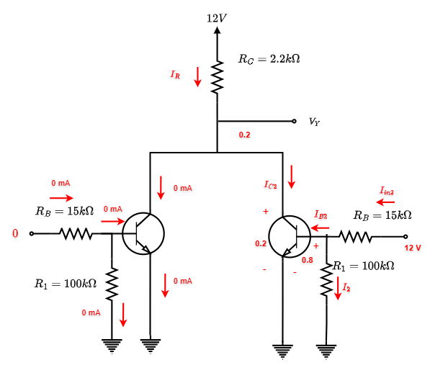
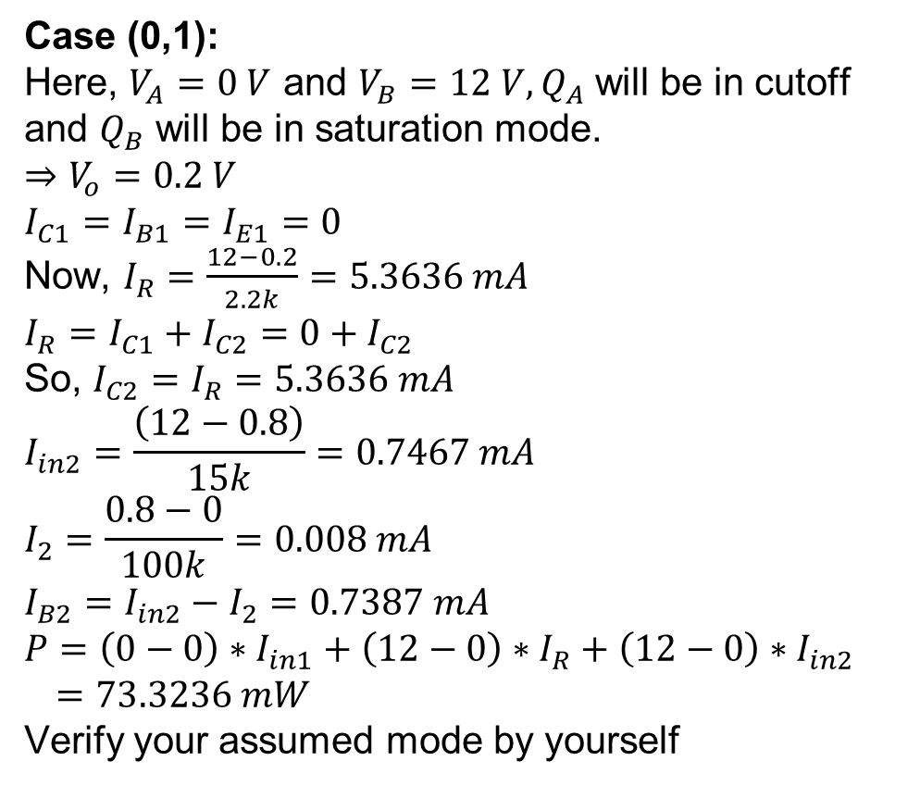
RTL NOR Gate
Case (0,1):
Here, $V_{A}=0 V$ and $V_{B}=12 V, Q_{A}$ will be in cutoff and $Q_{B}$ will be in saturation mode.
$$⇒V_{o}=0.2 V$$
$$I_{C1}=I_{B1}=I_{E1}=0$$
Now, $I_{R}=\frac{12−0.2}{2.2k}=5.3636 mA$
$$I_{R}=I_{C1}+I_{C2}=0+I_{C2}$$
So, $I_{C2}=I_{R}=5.3636 mA$
$$I_{in2}=\frac{\left(12−0.8\right)}{15k}=0.7467 mA$$
$$I_{2}=\frac{0.8−0}{100k}=0.008 mA$$
$$I_{B2}=I_{in2}−I_{2}=0.7387 mA$$
$$P=\left(0−0\right)∗I_{in1}+\left(12−0\right)∗I_{R}+\left(12−0\right)∗I_{in2}$$
$=73.3236 mW$
Verify your assumed mode by yourself

Slide 34
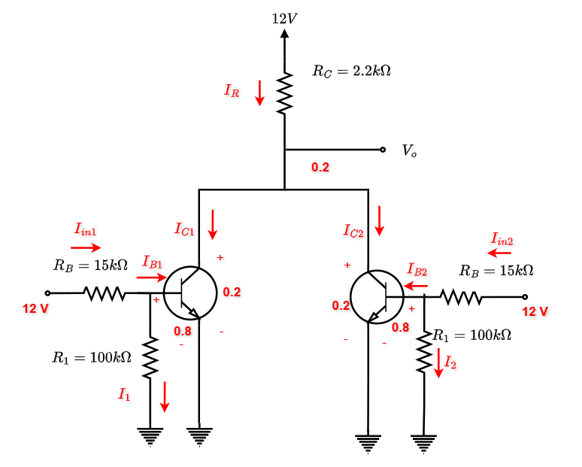
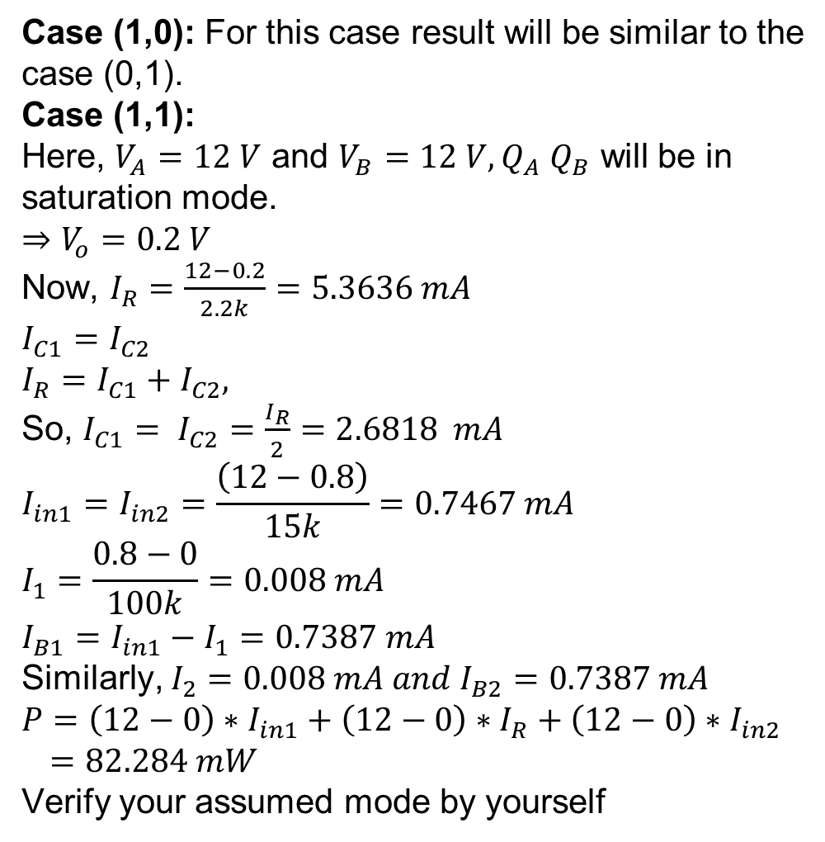
RTL NOR Gate
Case (1,0): For this case result will be similar to the case (0,1).
Case (1,1):
Here, $V_{A}=12 V$ and $V_{B}=12 V, Q_{A}$ $Q_{B}$ will be in saturation mode.
$$⇒V_{o}=0.2 V$$
Now, $I_{R}=\frac{12−0.2}{2.2k}=5.3636 mA$
$$I_{C1}=I_{C2}$$
$$I_{R}=I_{C1}+I_{C2},$$
So, ${I_{C1}= I}_{C2}=\frac{I_{R}}{2}=2.6818 mA$
$${I_{in1}=I}_{in2}=\frac{\left(12−0.8\right)}{15k}=0.7467 mA$$
$$I_{1}=\frac{0.8−0}{100k}=0.008 mA$$
$$I_{B1}=I_{in1}−I_{1}=0.7387 mA$$
Similarly, $I_{2}=0.008 mA and I_{B2}=0.7387 mA$
$$P=\left(12−0\right)∗I_{in1}+\left(12−0\right)∗I_{R}+\left(12−0\right)∗I_{in2}$$
$=82.284 mW$
Verify your assumed mode by yourself

Slide 35
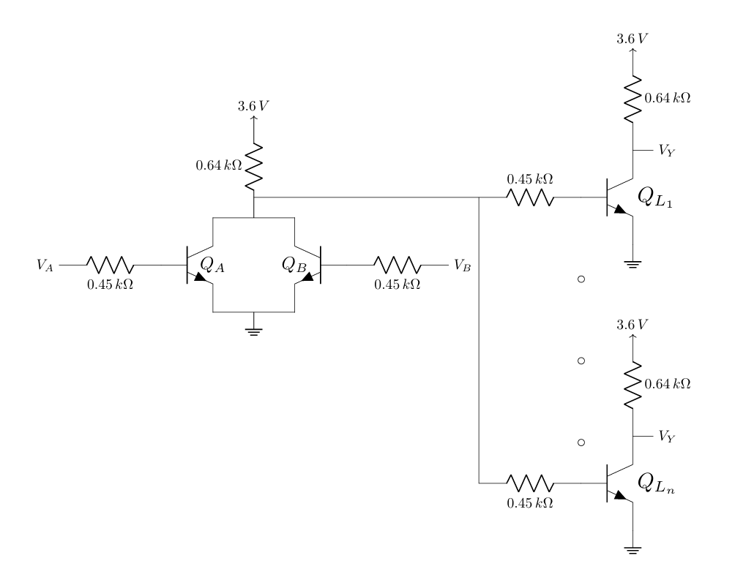
RTL NOR Gate
If for the given RTL NOR driver & RTL NOT loads, βF = 30, VOH = 3V & VOL = 0.2V, find the maximum fanout.

